Slide 1

MOBILE Applications Using Android
ANDROID MENUS & DIALOGS

Slide 2

CONTENT
Menus
Options menu
Context menu
Sub menu
Creating different Menus
2. Dialogs
Alert Dialog
Progressbar dialog
DatePicker dialog
TimePicker Dialog
Toast
Creating different dialogs

Slide 3
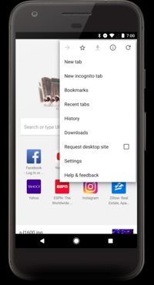
Menus provide familiar interfaces to expose application functions without sacrificing screen space.
Android offers an easy programming interface to provide standardized application menus.

Slide 4
Options Menus
The options menu is the primary collection of menu items for an activity. It's where you should place actions that have a global impact on the app, such as "Search," "Compose email," and "Settings."

Slide 5
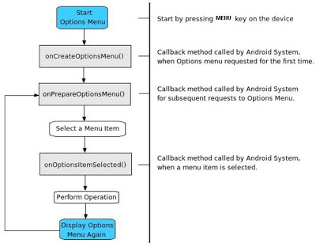
Options Menu Life Cycle

Slide 6
Context menu and contextual action mode
A context menu is a floating menu that appears when the user performs a long-click on an element. It provides actions that affect the selected content or context frame.
The contextual action mode displays action items that affect the selected content in a bar at the top of the screen and allows the user to select multiple items.

Slide 7
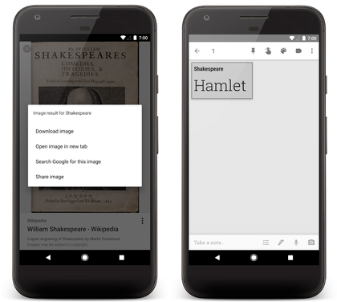

Slide 8
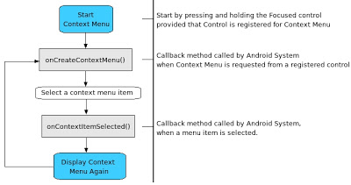
Context Menu Life Cycle

Slide 9
Sub Menus
- Sub menu is a floating menu, it can be a child menu of options menu or context menu. - It supports checkboxes, radio buttons and shortcut keys. - It does not support item icons, or nested sub menus.

Slide 10
Popup menu
A popup menu displays a list of items in a vertical list that's anchored to the view that invoked the menu. It's good for providing an overflow of actions that relate to specific content or to provide options for a second part of a command. Actions in a popup menu should not directly affect the corresponding content—that's what contextual actions are for. Rather, the popup menu is for extended actions that relate to regions of content in your activity.

Slide 11
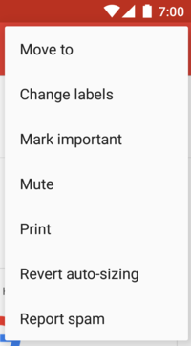

Slide 12


CREATING MENUS
By default an Activity is associated with a single menu
Android creates this single menu and passes it to the onCreateOptionsMenu callback method
This method allows you to populate the menu with a set of menu items
Once the menu items are populated, the code should return true to make the menu visible
If this method returns false, the menu becomes invisible
@Override
public boolean onCreateOptionsMenu(Menu menu)
{
// populate menu items
…..
...return true;
}

Slide 13
ADDING MENU ITEMS
Menus Items can be grouped together by assigning each one a group ID.
Multiple menu items that carry the same group ID are considered part of the same group
The order of menu items within a menu is defined by the sort-order ID property
Some of these order-number ranges are reserved for certain kinds of menus.
Secondary menu items: considered less important start at 0x30000 and are defined by the constant Menu.CATEGORY_SECONDARY
System menus, alternative menus, and container menus—have different order-number ranges

Slide 14
ADDING MENU ITEMS
@Override
public boolean onCreateOptionsMenu(Menu menu)
{
//call the base class to include system menus
super.onCreateOptionsMenu(menu);
menu.add(0 // Group id
,1 // item id
,0 // sort order id
,”menu item 1"); // title
menu.add(0,2,1,”menu item 2");
menu.add(0,3,2,”menu item 3");
return true;
}

Slide 15
RESPONDING TO MENU ITEMS
Multiple ways of responding to menu-item clicks in Android
onOptionsItemSelected method
Listeners
Intents
When a menu item is clicked, Android calls the onOptionsItemSelected callback method on the Activity class
@Override
public boolean onOptionsItemSelected(MenuItem item)
{
switch(item.getItemId()) {
//handle menu items click
return true;
}
return super.onOptionsItemSelected(item);
}

Slide 16
CREATING MENUS USING XML
Define an XML file with menu tags
Place the file in the /res/menu subdirectory
The name of the file is arbitrary
You can have as many files as you want
Use the resource ID of the menu file to load the XML file into the menu
Respond to the menu items using the resource IDs generated for each menu item
<menu xmlns:android="http://schemas.android.com/apk/res/android">
<!-- This group uses the default category. -->
<group android:id="@+id/menuGroup_Main">
<item android:id="@+id/menu_testPick"
android:orderInCategory="5"
android:title="Test Pick" />
<item android:id="@+id/menu_testGetContent"
android:orderInCategory="5"
android:title="Test Get Content" />
<item android:id="@+id/menu_clear"
android:orderInCategory="10"
android:title="clear" />
<item android:id="@+id/menu_dial"
android:orderInCategory="7"
android:title="dial" />
<item android:id="@+id/menu_test"
android:orderInCategory="4"
android:title="@+string/test" />
</group>
</menu>

Slide 17
INFLATING XML MENU
Android provides a class called android.view.MenuInflater to populate Menu objects from XML
@Override
public boolean onCreateOptionsMenu(Menu menu)
{
MenuInflater inflater = getMenuInflater();
inflater.inflate(R.menu.menu1, menu);
}
Responding to XML Based
private void onOptionsItemSelected (MenuItem item)
{
if (item.getItemId() == R.id.menu_clear)
{
//do something
}
…
}

Slide 18
DIALOGS
A dialog is usually a small window that appears in front of the current Activity
The underlying Activity loses focus and the dialog accepts all user interaction
Dialogs are normally used for notifications and short activities that directly relate to the application in progress.
4 types of dialogs are there
Alert Dialog
Progress Dialog
Date Picker Dialog
Time Picker Dialog

Slide 19
Alert Dialog
A dialog that can manage zero, one, two or three buttons.
It can also manage a list of selectable items that can include
checkboxes or radio buttons.
The AlertDialog is capable of constructing most dialog user
interfaces and is the suggested dialog type.
AlertDialog class is a subclass of Dialog class and has a nested
subclass.
AlertDialog.Builder to construct a dialog.

Slide 20
Create Dialog
A dialog is always created and displayed as a part of an Activity.
Activity provides following methods to create and display dialogs:
onCreateDialog(int id)
onPrepareDialog(int id, Dialog dialog)
showDialog(int id)
Override the onCreateDialog(int id) callback method to create a dialog.
Override the onPrepareDialog(id, dialog) callback method to populate the dialog over the screen each time it gets displayed.
Call the showDialog(int id) method to display a dialog.

Slide 21
MANAGING DIALOGS
When a dialog is requested for the first time, Android calls onCreateDialog
onCreateDialog is where the dialog is instantiated, it is called once for a dialog
Before the dialog is displayed, Android also calls the optional callback method onPrepareDialog
onPrepareDialog is used to change any properties of the dialog each time it is opened, it is called each time the dialog is requested
Instantiating Dialogs
protected Dialog onCreateDialog(int id)
{
Dialog dialog;
switch(id)
{
case DIALOG_PAUSED_ID:
// do the work to define the pause Dialog break;
case DIALOG_GAMEOVER_ID:
// do the work to define the game over Dialog break;
default: dialog = null;
}
return dialog
}

Slide 22
ALERT DIALOG
An AlertDialog is an extension of the Dialog class that contains:
A title
A text message
One, two, or three buttons
A list of selectable items (with optional checkboxes or radio buttons)
Building alert dialogns
AlertDialog.Builder builder = new AlertDialog.Builder(this);
builder.setMessage("Are you sure you want to exit?")
.setCancelable(false)
.setPositiveButton("Yes",
new DialogInterface.OnClickListener() {
public void onClick(DialogInterface dialog, int id) {
MyActivity.this.finish(); } })
.setNegativeButton("No", new DialogInterface.OnClickListener() {
public void onClick(DialogInterface dialog, int id) {
dialog.cancel(); } });
AlertDialog alert = builder.create();

Slide 23
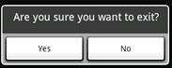
ALERT DIALOG
setMessage: adds a message for the dialog
setCancelable: define if a user can exit from the dialog using the back button
setPositiveButton: adds buttons to the dialog

Slide 24

PROGRESS DIALOG
A ProgressDialog is an extension of the AlertDialog class that can display a progress animation in the form of a spinning wheel
The dialog can also provide buttons, such as one to cancel a download
ProgressDialog dialog = ProgressDialog.show(
MyActivity.this,"",
"Loading. Please wait...", true);

Slide 25
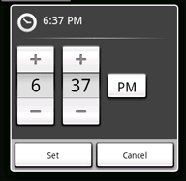
TIMEPICKER DIALOG
public TimePickerDialog (
Context context,
TimePickerDialog.OnTimeSetListener callback,
Int hourOfDay,
int minute,
boolean is24HourView)
callBack How parent is notified.
hourOfDay The initial hour.
minute The initial minute.
is24HourView Whether this is a 24 hour view, or AM/PM.

Slide 26
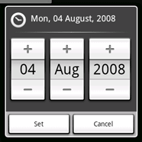
DATEPICKER DIALOG
Public DatePickerDialog (
Context context,
DatePickerDialog.OnDateSetListener callback,
int year,
int monthOfYear,
int dayOfMonth )
Context The context of the dialog is to where its run.
callBack How the parent is notified that the date is set.
year The initial year of the dialog.
monthOfYear The initial month of the dialog.
dayOfMonth The initial day of the dialog.

Slide 27
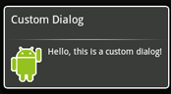
CUSTOM DIALOG
<LinearLayout xmlns:android="http://schemas.android.com/apk/res/android"
android:id="@+id/layout_root"
android:orientation="horizontal"
android:layout_width="fill_parent"
android:layout_height="fill_parent"
android:padding="10dp">
<ImageView android:id="@+id/image"
android:layout_width="wrap_content"
android:layout_height="fill_parent"
android:layout_marginRight="10dp"
/>
<TextView android:id="@+id/text"
android:layout_width="wrap_content"
android:layout_height="fill_parent"
android:textColor="#FFF"
/>
</LinearLayout>
Context mContext = getApplicationContext();
Dialog dialog = new Dialog(mContex);
dialog.setContentView(R.layout.custom_dialog);
dialog.setTitle(Custom Dialog)”;
TextView text = (TextView) dialog.findViewById(R.id.text);
text.setText("Hello, this is a custom dialog!");
ImageView image = (ImageView)
dialog.findViewById(R.id.image);
image.setImageResource(R.drawable.android;

